Slide 1
Rotten Visualizations
Jose Diaz - Data Visualization Spring 2021

Slide 2

Goal
The goal of this project was simple. With the Rotten Tomatoes dataset providing data on movie ratings going as far back as 1920, I wanted to find interesting facts and insights that would be near impossible to find by just looking at an excel sheet
These insights could then be used from making interesting social media posts for brands that have a strong film audience thus creating more value for the brand
Or these insights could be used to help production companies looking to achieve better movies. Better movies meaning movies with higher ratings.

Slide 3
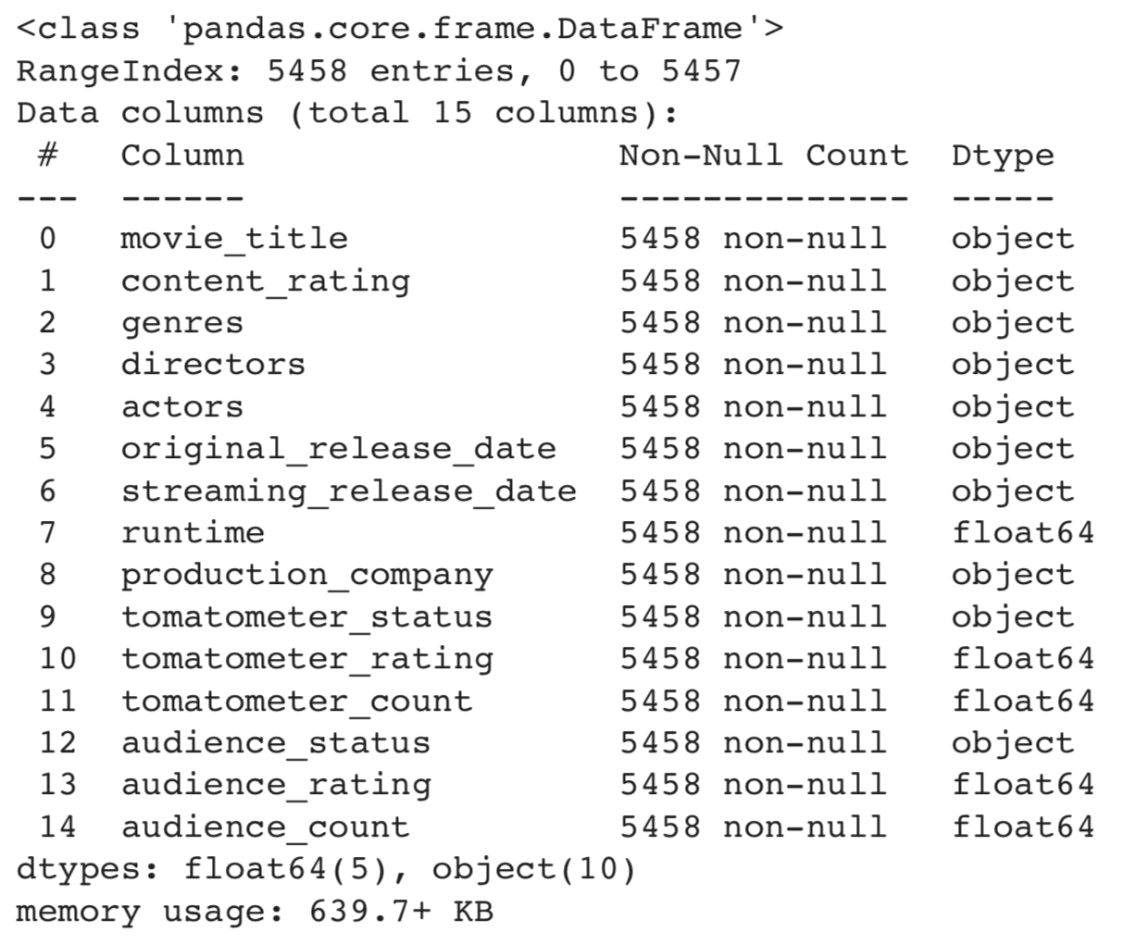
Description of Data
The dataset that I used can be found here: https://www.kaggle.com/stefanoleone992/rotten-tomatoes-movies-and-critic-reviews-dataset?select=rotten_tomatoes_movies.csv
The original dataset came with 22 features but when cleaning I got it down to 15
The features that I removed had to do with things such as URLs and rotten tomatoes identifiers and were not relevant to movie data
I also made sure to remove rows where I had missing values
My final dataset looked like this:

Slide 4



Software Tools
Python
Pandas
Plotly / Plotly Express
I chose to use plotly because it was my favorite tool that we used over the course of the semester. It proved to be simple enough to use that some figures were made with almost no thought added. But sophisticated enough to wear I could make the graphs look exactly how I wanted

Slide 5
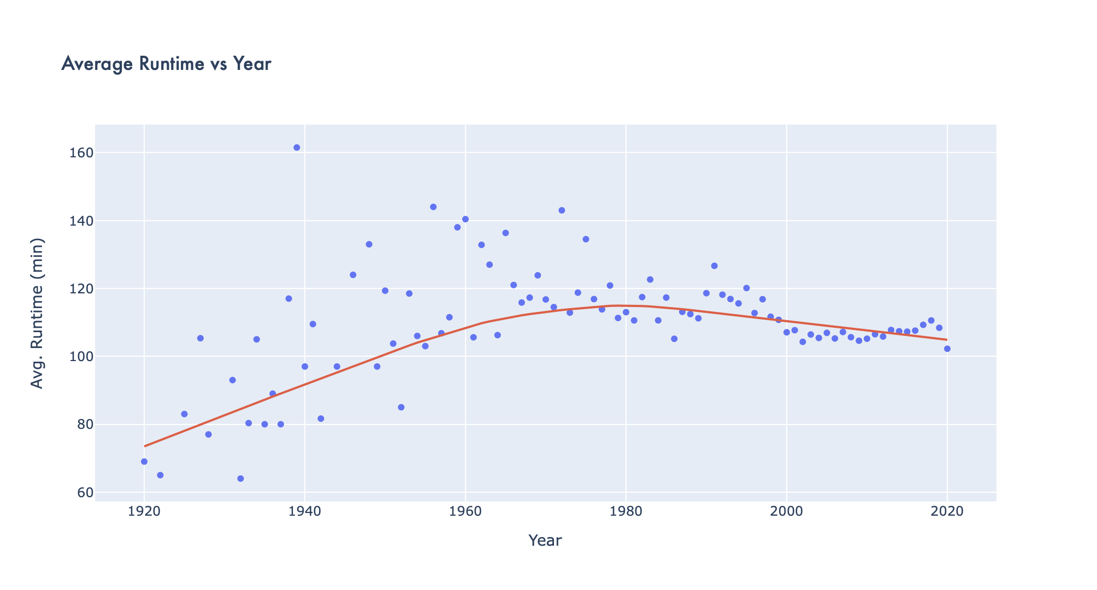

Slide 6
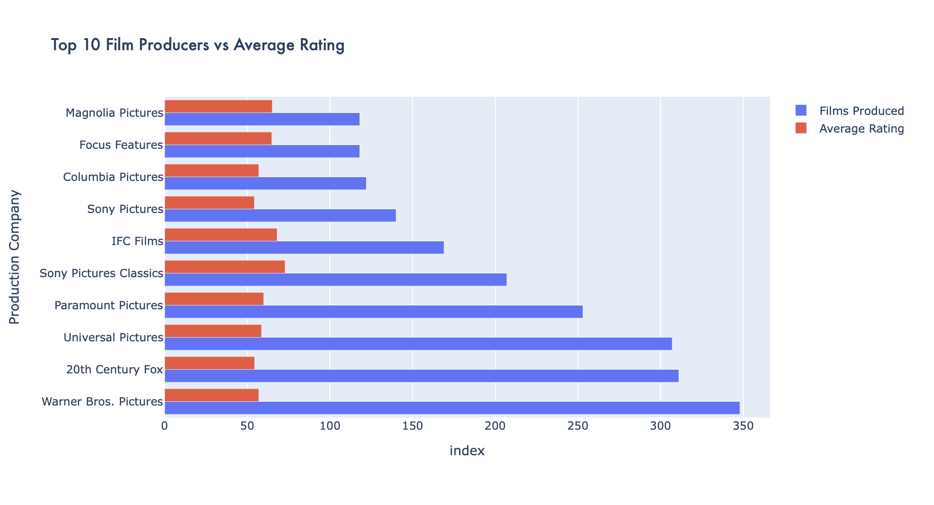

Slide 7
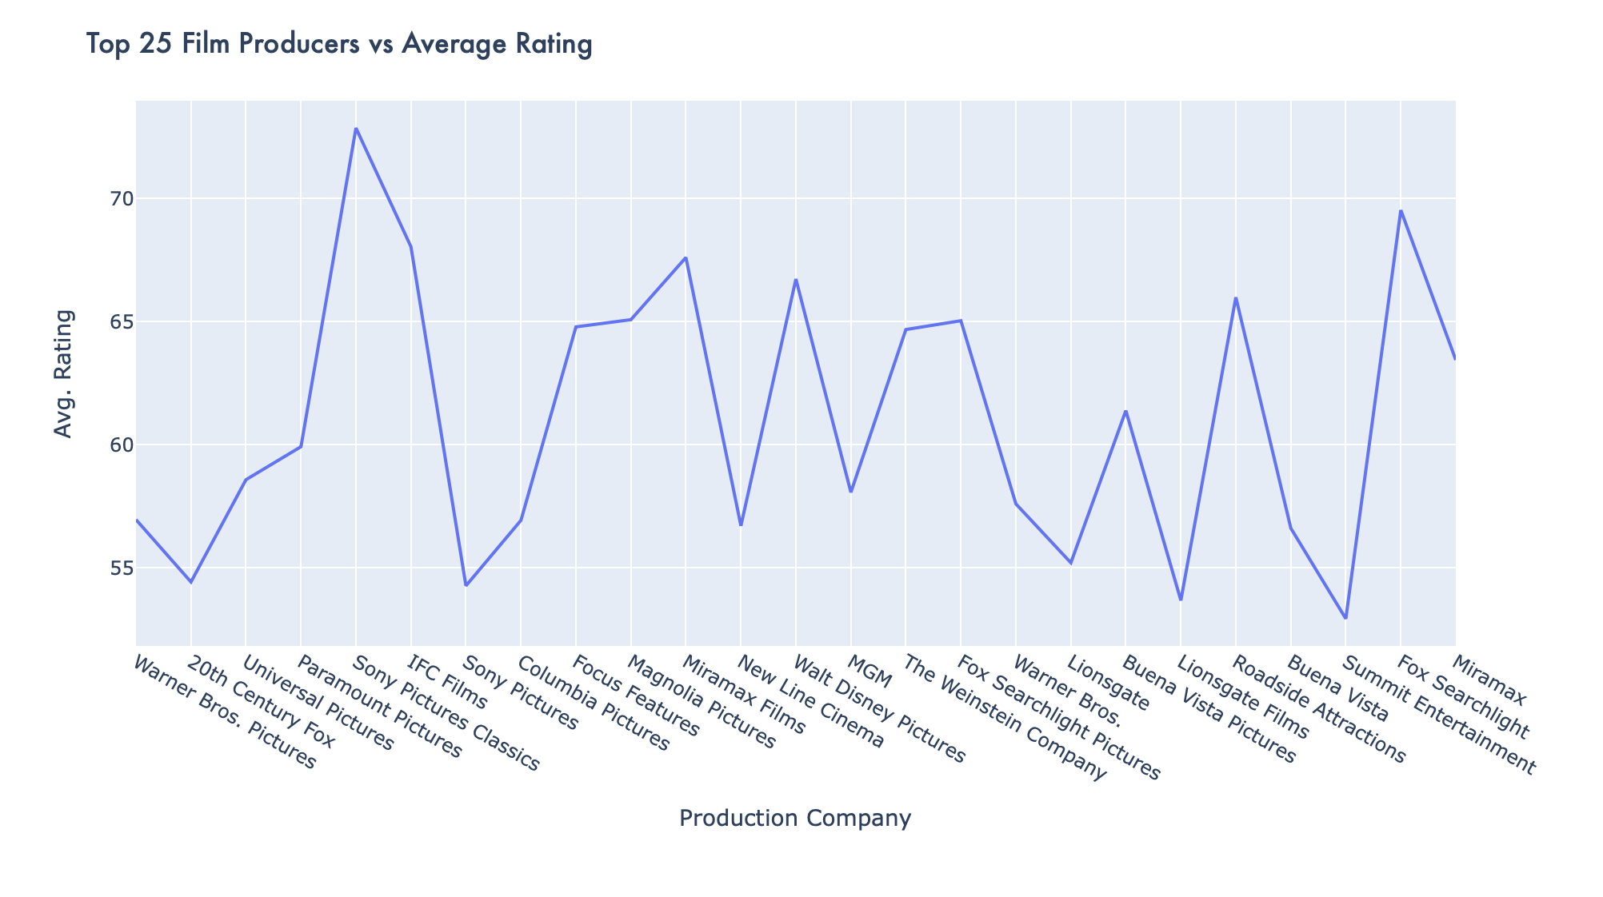

Slide 8
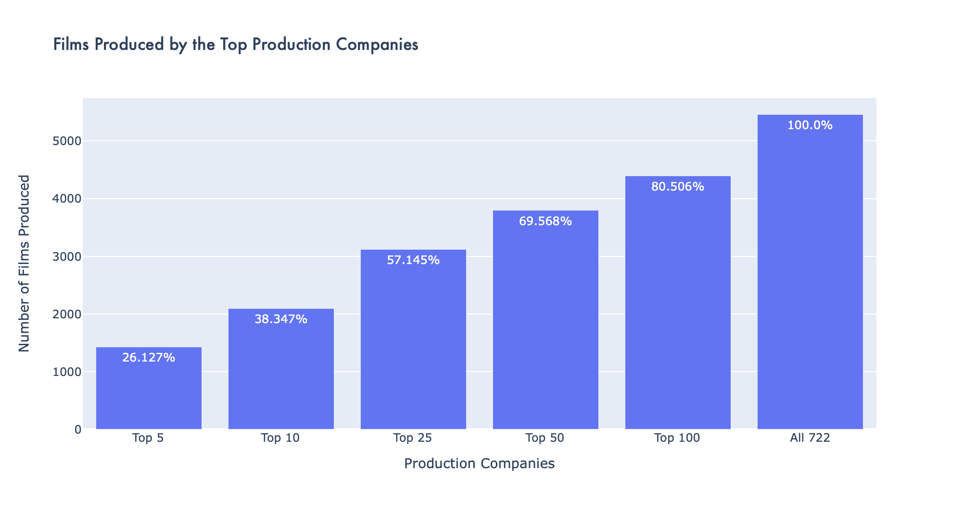

Slide 9
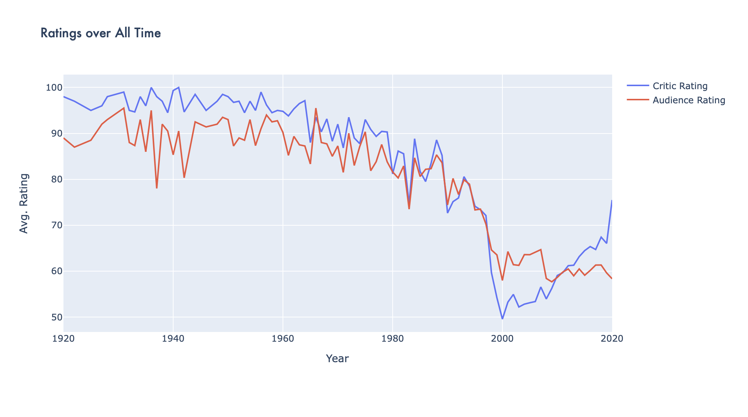

Slide 10
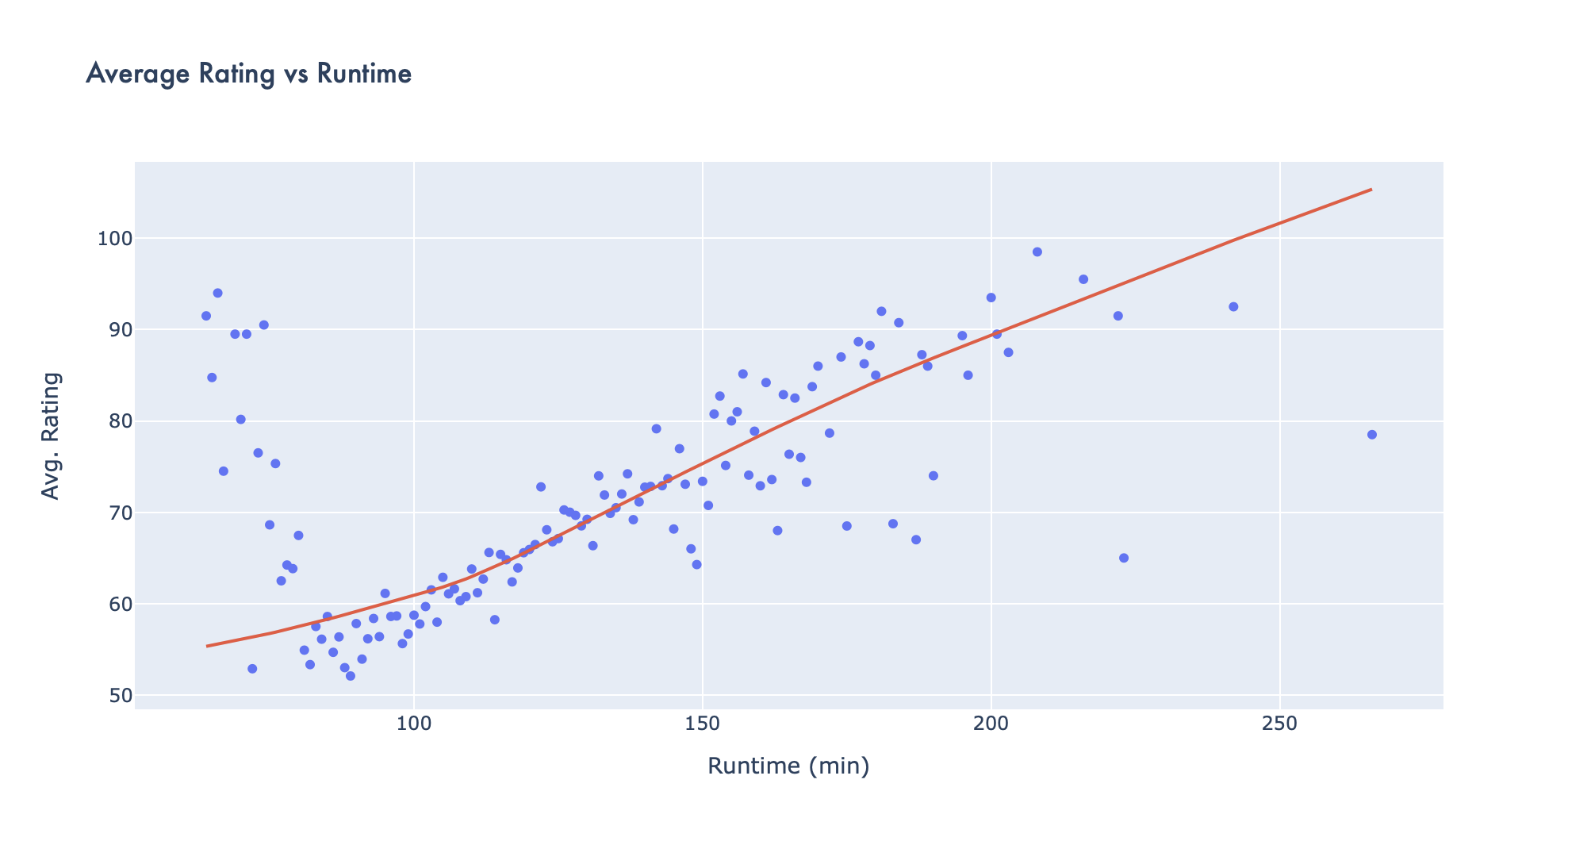

Slide 11
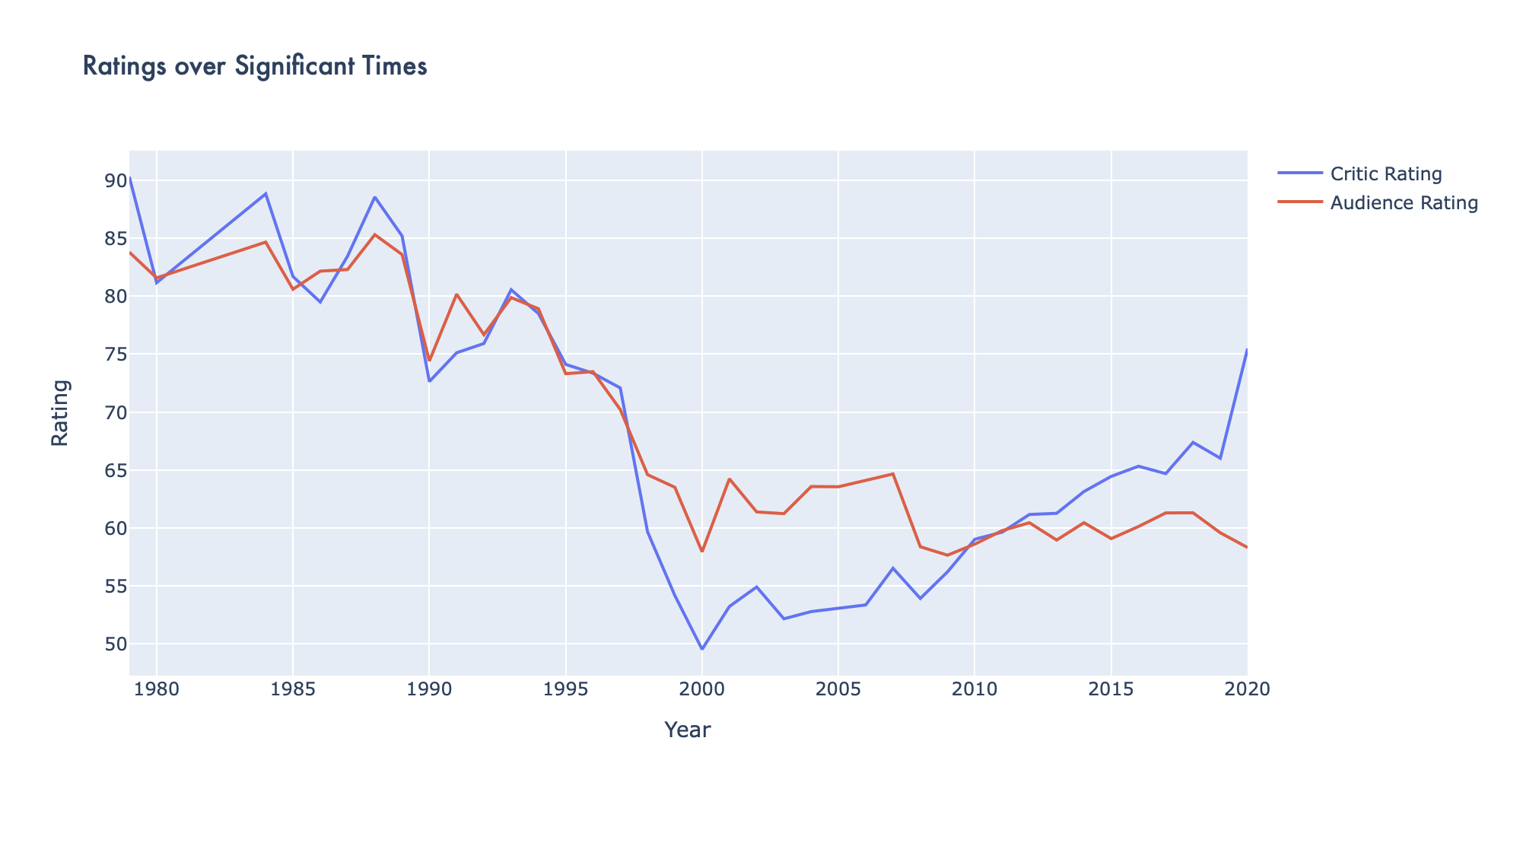

Slide 12
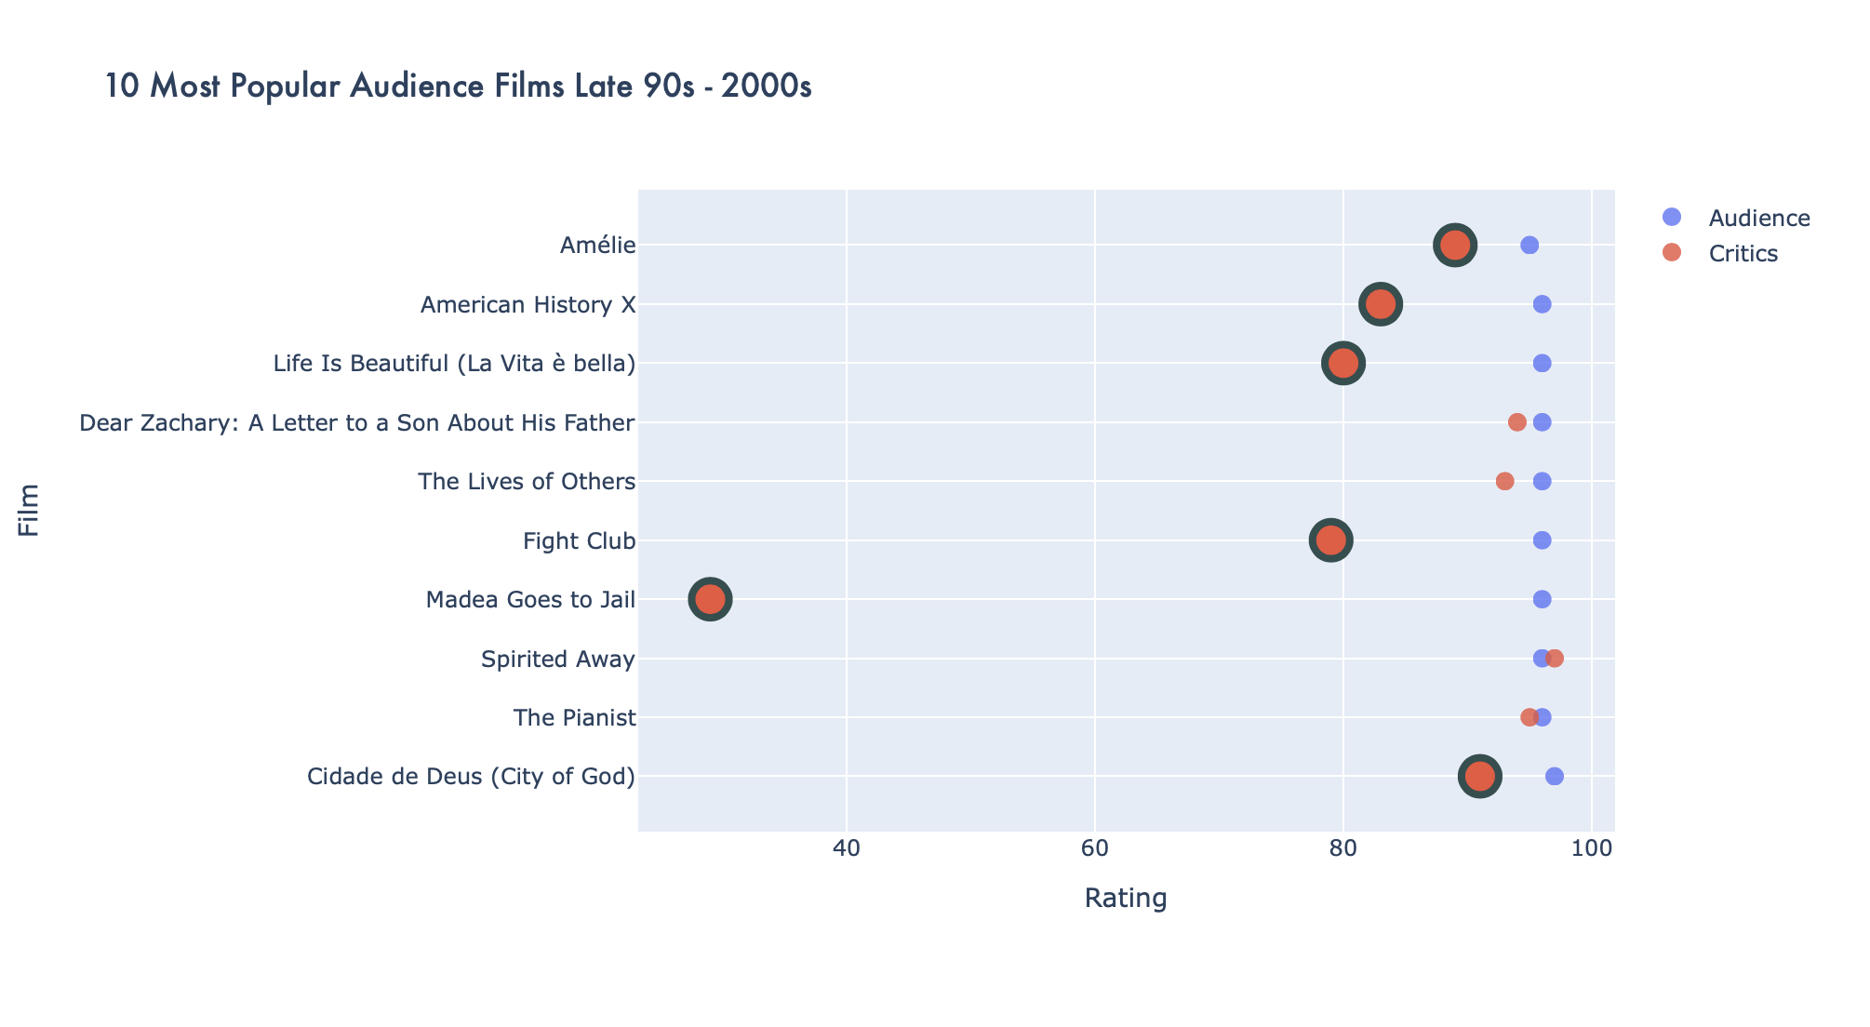

Slide 13
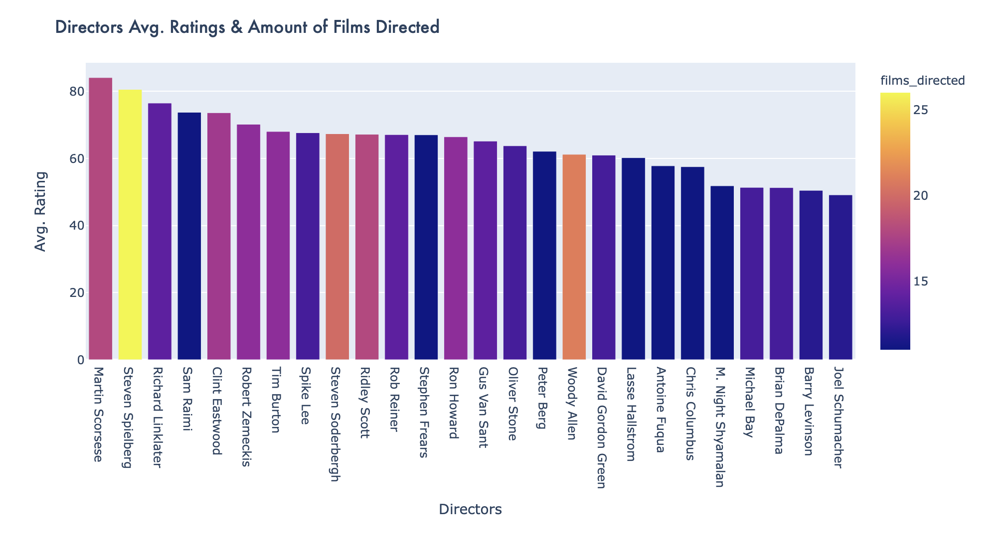

Slide 14
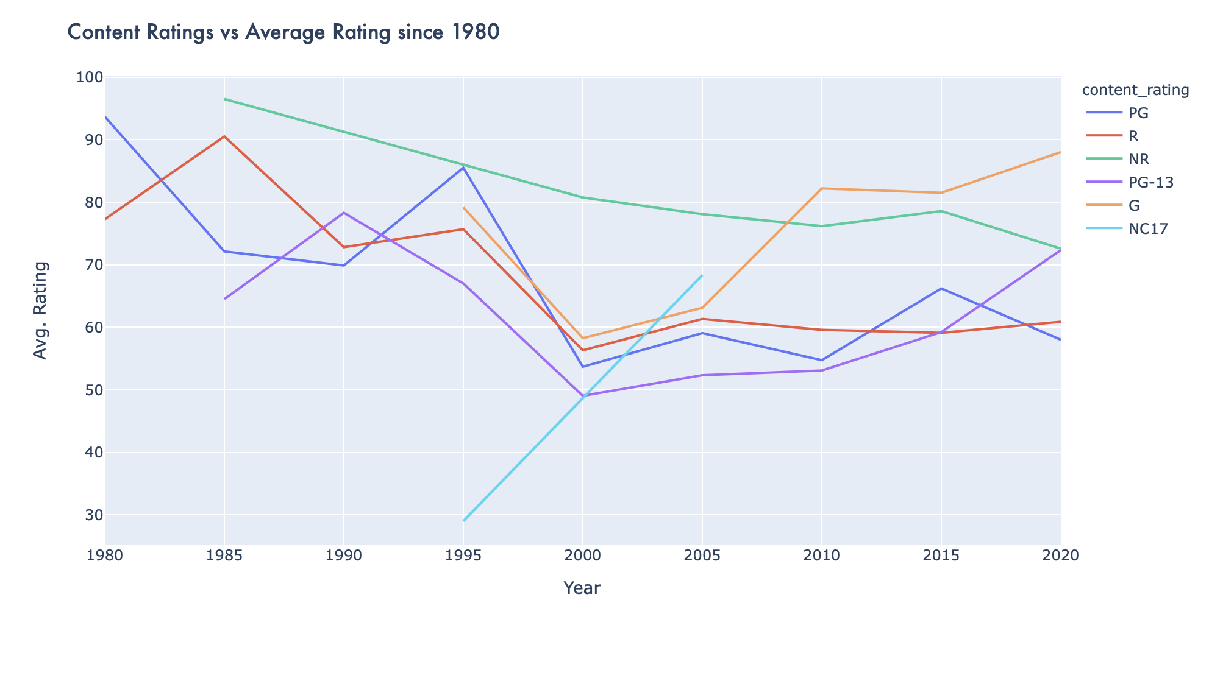

Slide 15
Conclusions
In conclusion I would say that I learned a lot from this project and even more from this class
I believe that the interesting tidbits and insights that I have found can and do have value
Looking at an excel sheet I would have never known that the length of movies is starting to decline or that the most highly rated director is not the one that has directed the most films
I also learned that with even this small dataset, there are hundreds of visualizations that could be done and really shows that the possibilities are endless
Some struggles I had were working with columns that had lists as values. This was especially true with my dataset where films were often categorized as more than one genre

